Slide 1
ARM Instruction Set

Slide 2
ARM Instruction Set
Instructions process data held in registers and access memory with load and store instructions.
Classification of instructions
Data processing instructions
Data Transfer Instructions - Load-Store instructions
Control flow instructions – Conditional & Branching instructions
S/W interrupt instructions
Program status register instructions

Slide 3
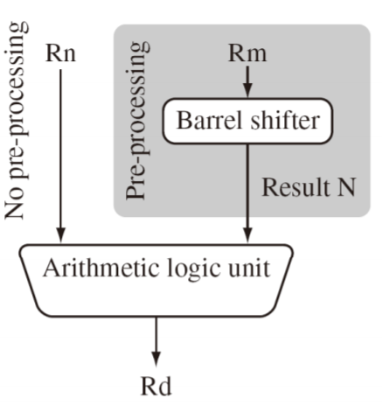
1. Data Processing Instructions
Perform arithmetic, logical, move, compare and multiply operations
All operations except multiply instructions are carried out in ALU
Uses 3- address instruction format:
Eg: ADD R0,R1,R2 ; R0 = R1+R2
All operands are 32 bits wide.
From register.
Specified as literals in instruction itself.
Result is 32 bits wide
Stored in register file.
Most Data Processing instructions can Pre-process one operand
using barrel shifter.
Eg: ADD R0,R1,R2, LSL #2 ; R2 = LSL by 2 position
; R0 = R1+R2

Slide 4
1. Data processing
Manipulate data within register
1.1 Arithmetic instructions
1.2 Logical instructions
1.3 Move instructions
1.4 Comparison instruction

Slide 5
1.1 Arithmetic Instructions
ADD add
ADC add with carry
SUB subtract
SBC subtract with carry
RSB reverse subtract
RSC reverse subtract with carry
ADD r0,r1,r2
ADC r0,r1,r2
SUB r0,r1,r2
SBC r0,r1,r2
RSB r0,r1,r2
RSC r0,r1,r2
Carry-in is the current value of C bit in CPSR

Slide 6
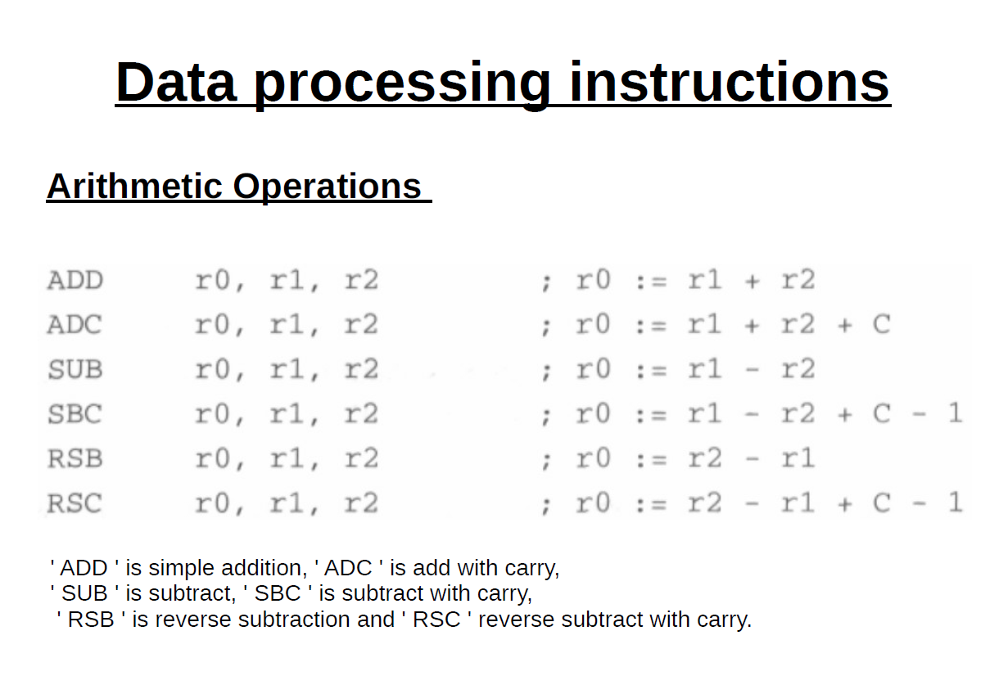

Slide 7
1.2 Bit-wise logical operations
AND r0,r1,r2
ORR r0,r1,r2
EOR r0,r1,r2
BIC r0,r1,r2
BIC
Bit Clear
Every ‘1’ in the second operand clears the corresponding bit in the first.

Slide 8
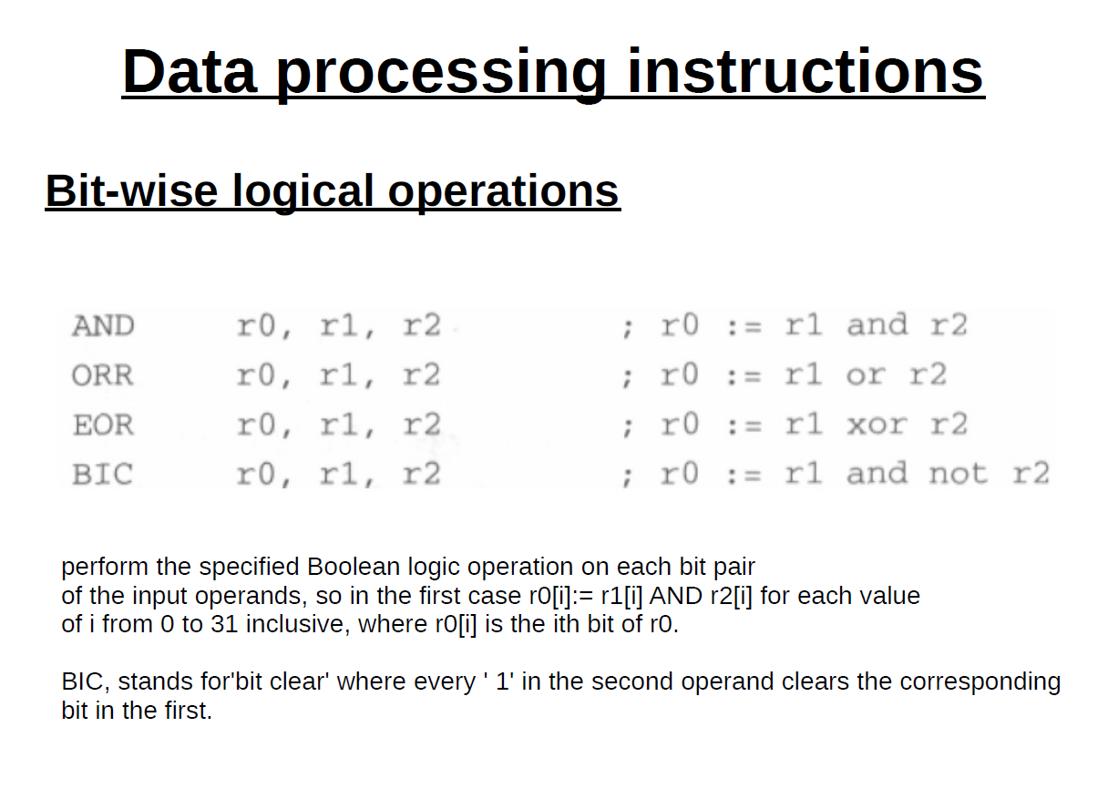

Slide 9
1.3 Register- Register movement operations
MOV Rd, N
Rd :destination register
N: can be an immediate value or source register
Example: MOV r7,r5
MVN Rd, N
Move into Rd negated value of the 32 bit value from source (N’).
Example: MVN r7,r5

Slide 10
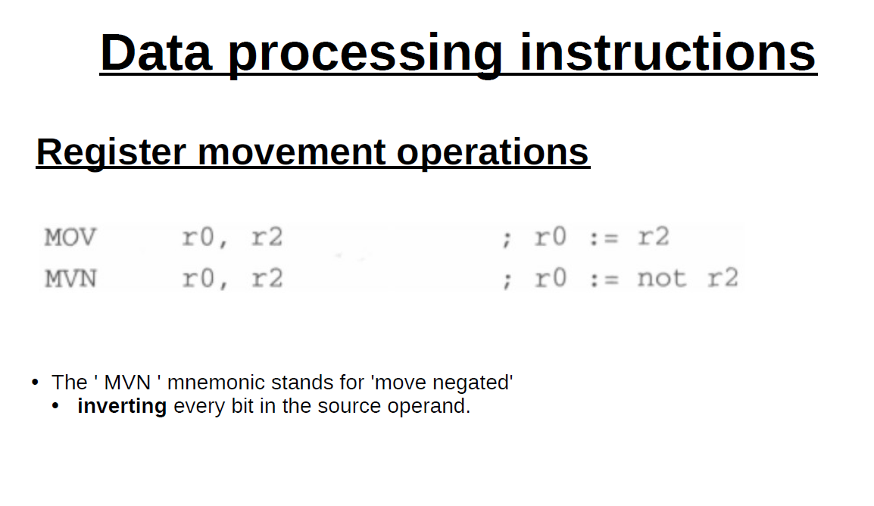

Slide 11
1.4 Comparison
Enables comparison of 32 bit values
Updates CPSR flags but do not affect other registers
CMP r1,r2 compare
CMN r1,r2 compare negated

Slide 12
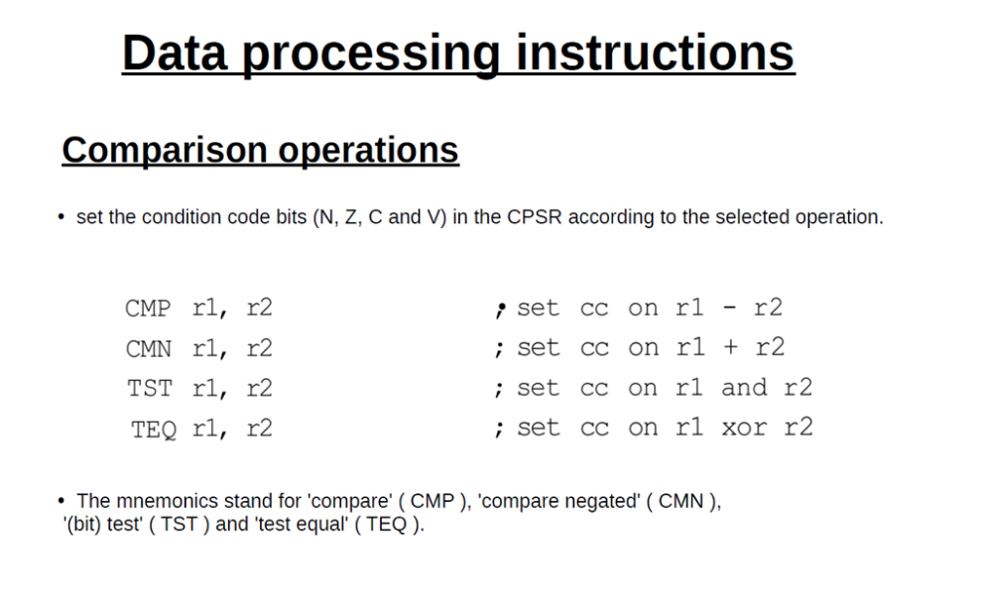

Slide 13
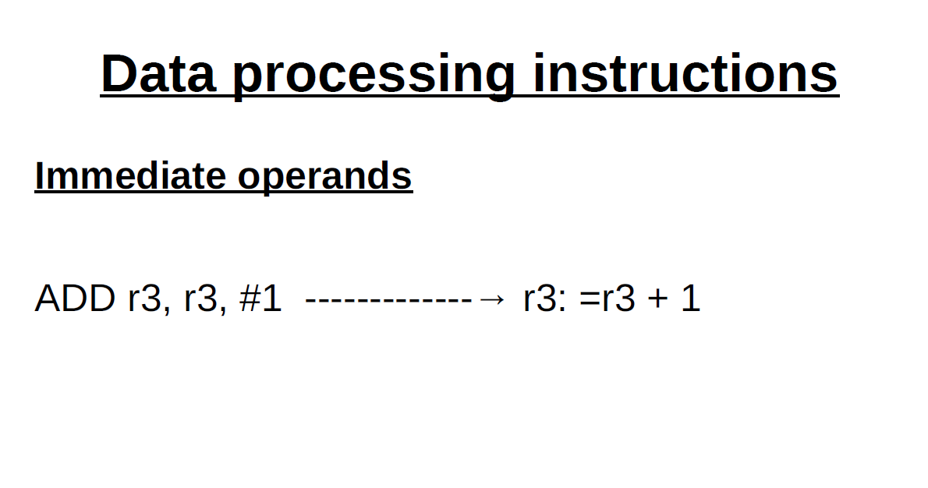

Slide 14
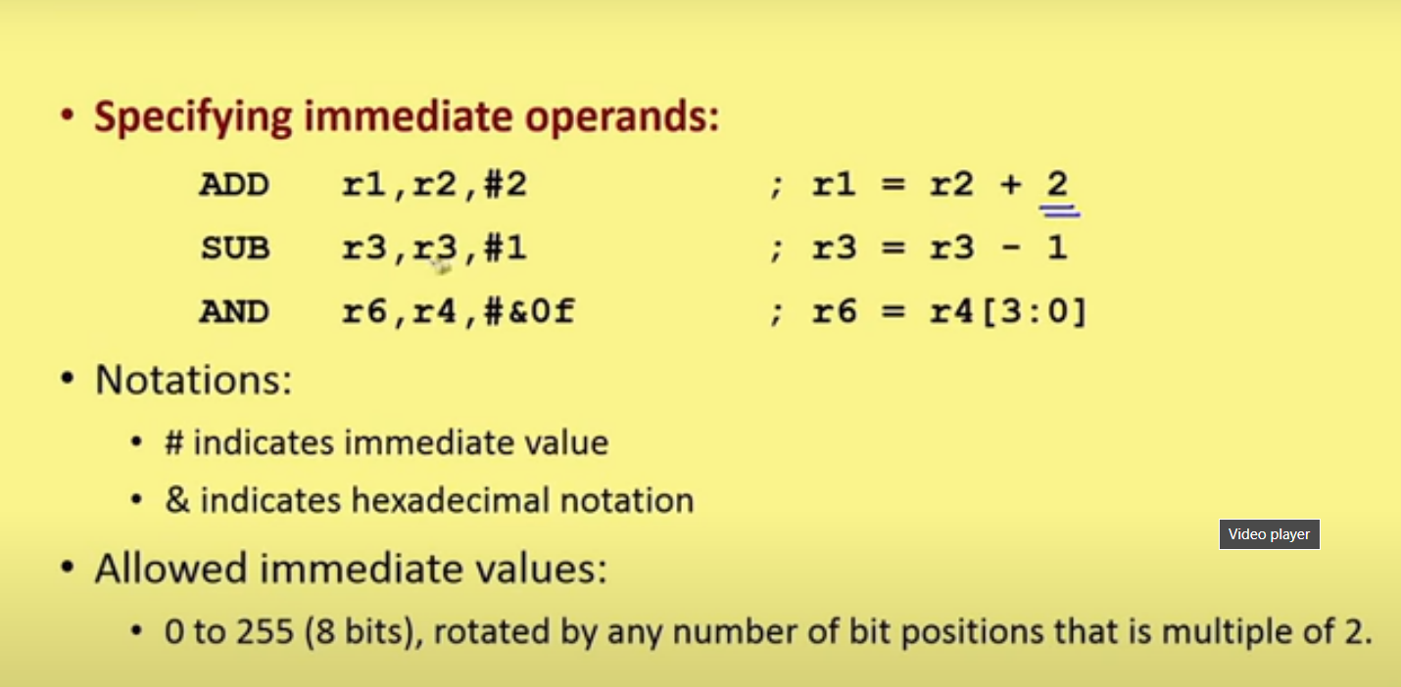

Slide 15
ADD r3,r2,r1, LSL #3
Shifted Register Operands
Single instruction.
Second reg operand subjected to shift.
LSL : Logical Shift Left.
Various shift & rotate operations:
Logical Shift Left (LSL),
Logical Shift Right (LSR),
Arithmetic Shift Left (ASL),
Arithmetic Shift Right (ASR),
Rotate Right (ROR),
Rotate Right Extended (RRX)

Slide 16
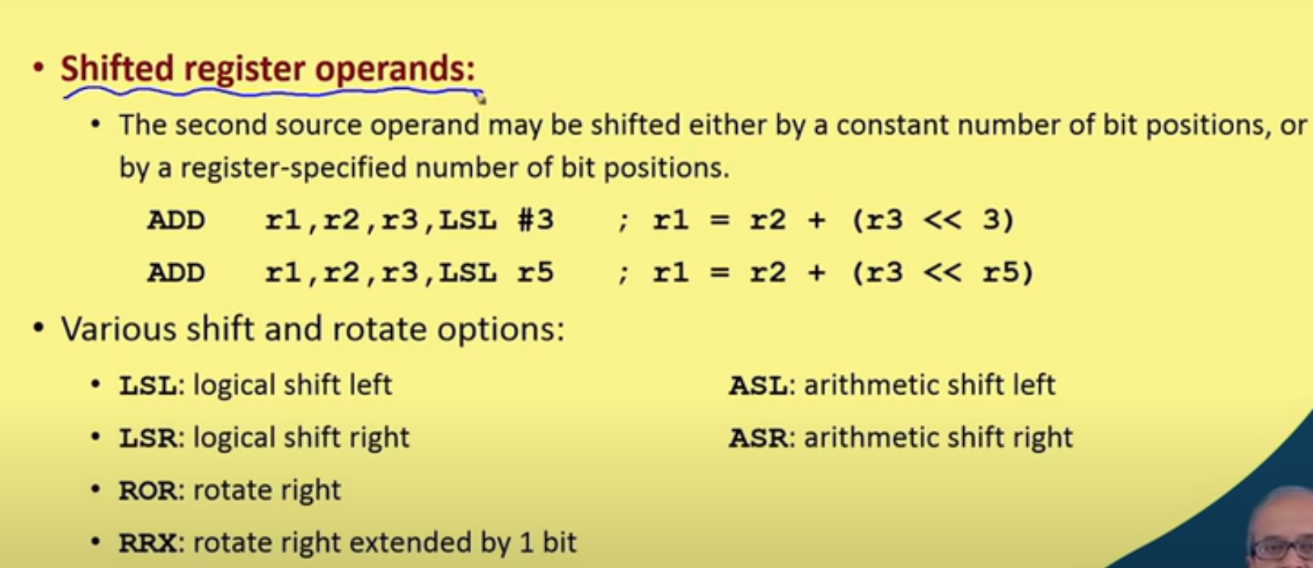

Slide 17
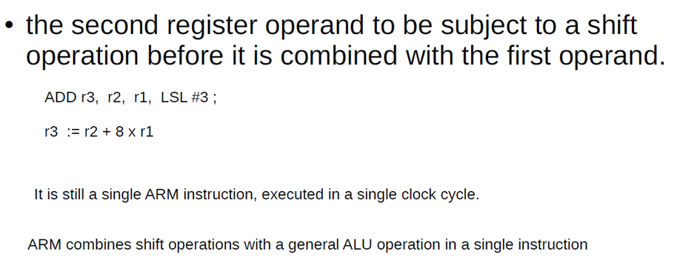
With Barrel shifter
Use of Barrel shifter with arithmetic and logical instructions increases the set of possible available operations.
Useful for fast multiplication and dealing with lists, table and other complex data structure.

Slide 18
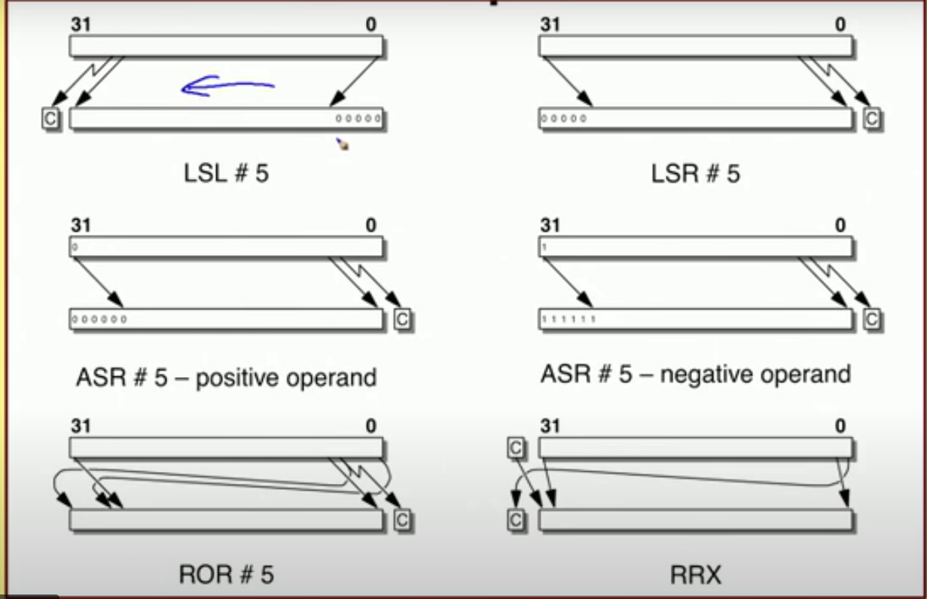

Slide 19
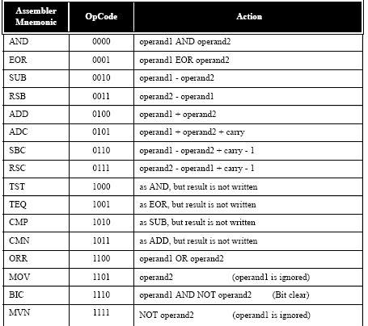

Slide 20
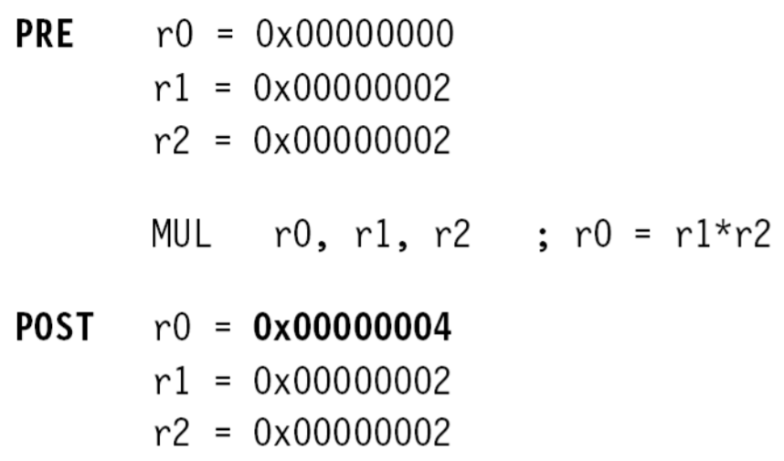
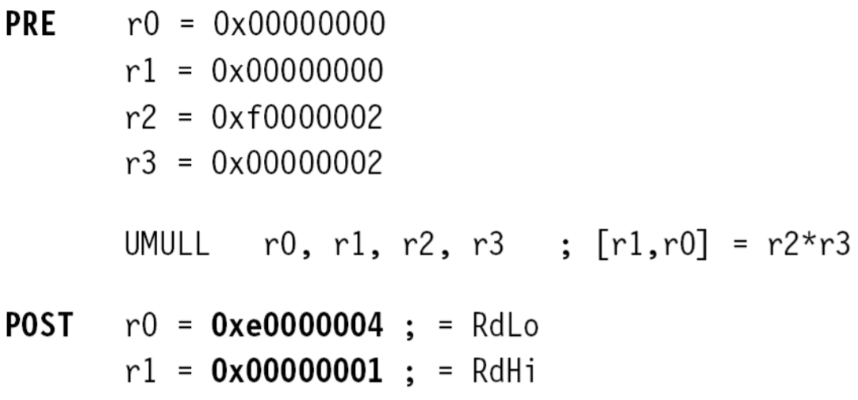
Multiply instructions
Multiply contents of a pair of registers
Multiplication by immediate constants not supported.
- long multiply generates 64 bit result
Examples:
→ mul r0,r1,r2
Contents of r1 and r2 multiplied and the result is put in r0.
→umull r0,r1,r2,r3 ; unsigned multiply long
Unsigned multiplication with result stored in r0 and r1.
Number of cycles taken for execution of multiplication instruction depends upon processor implementation.

Slide 21
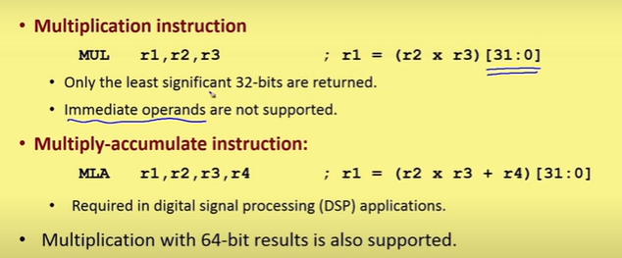

Slide 22
Multiply and Accumulate
Result of multiplication can be accumulated with content of another register
MLA Rd, Rn, Rm, Racc
Rd = (Rn*Rm)+Racc
UMLAL RdLo, RdHi, Rn, Rm
[RdHi,RdLo]=[RdHi,RdLo]+(Rn*Rm)

Slide 23
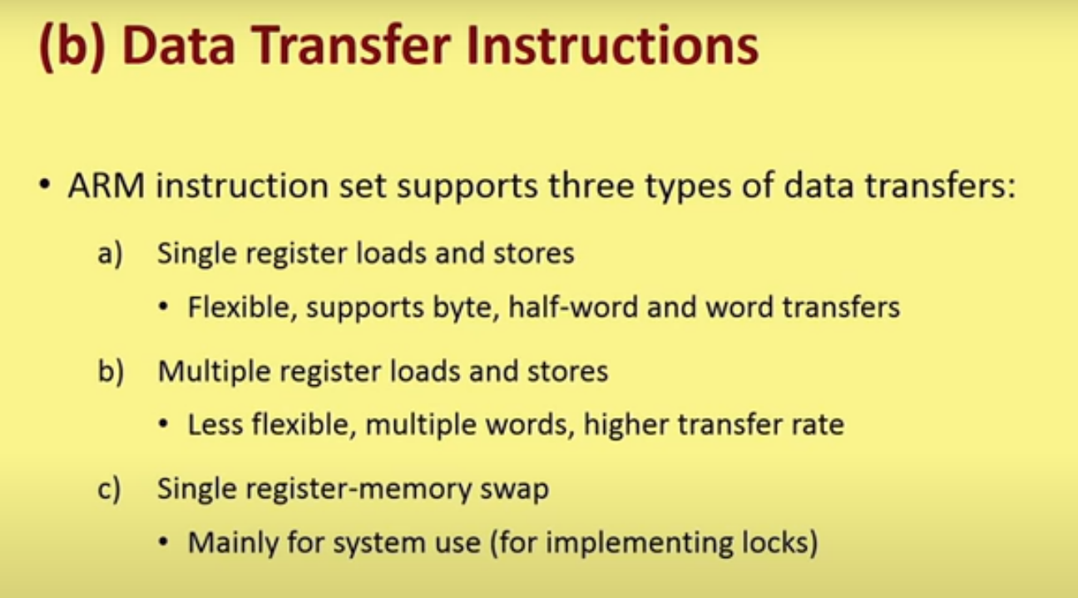

Slide 24
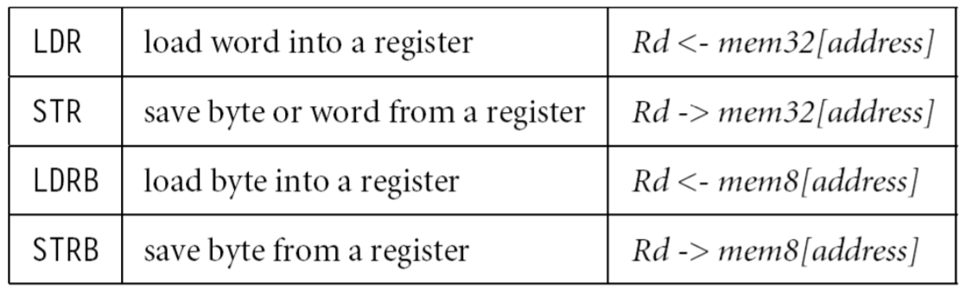
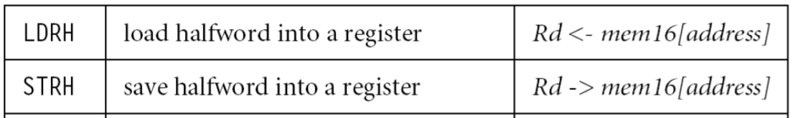
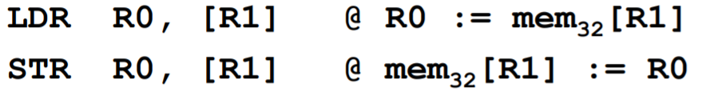
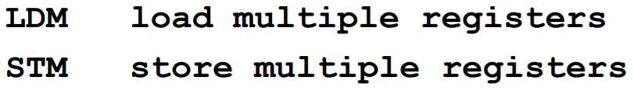
Data Transfer Instructions
Transfer data between memory and processor registers
Single register load/store
Data types supported are signed and unsigned words(32 bits), half word, bytes. Eg.
Multiple register load/store
Transfer multiple registers between memory and the processor in a single instruction
Swap
swaps content of a memory location with the contents of a register. For semaphore implementation. Eg. SWP (B)

Slide 25
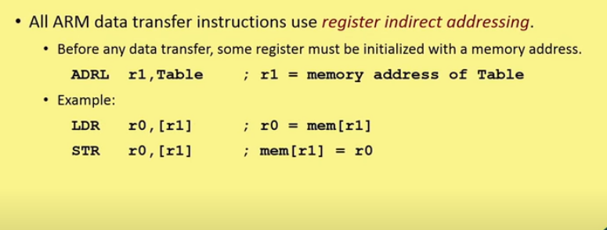

Slide 26
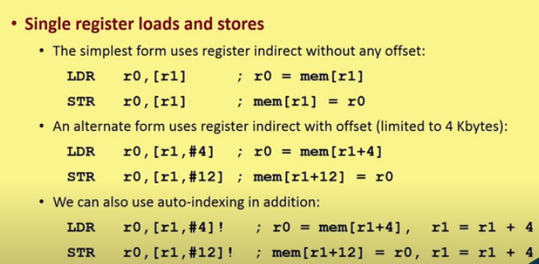

Slide 27
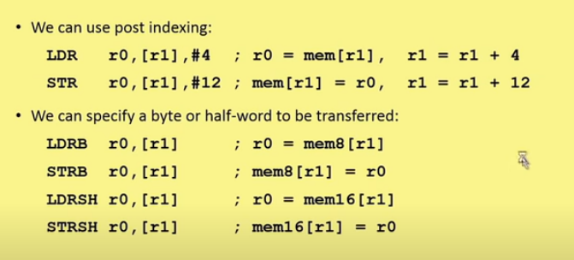

Slide 28
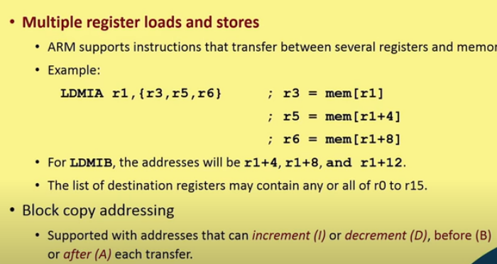

Slide 29
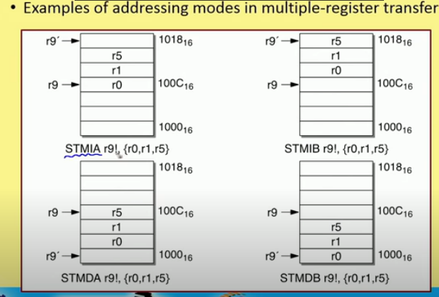
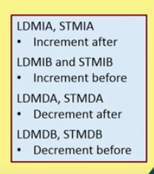

Slide 30
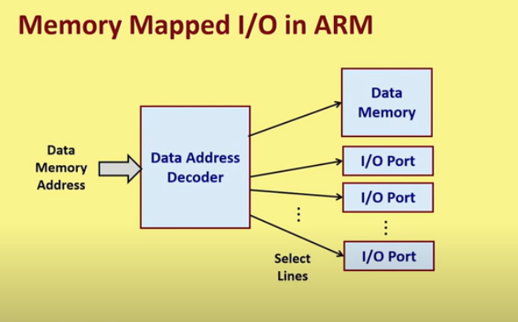

Slide 31
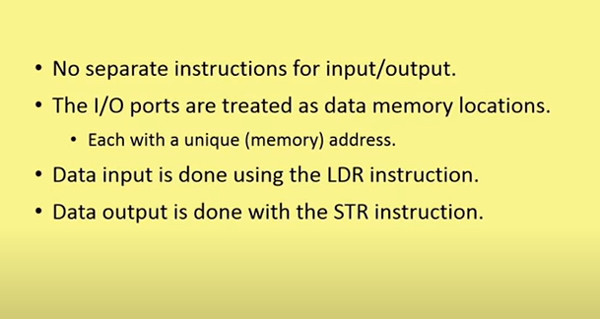

Slide 32
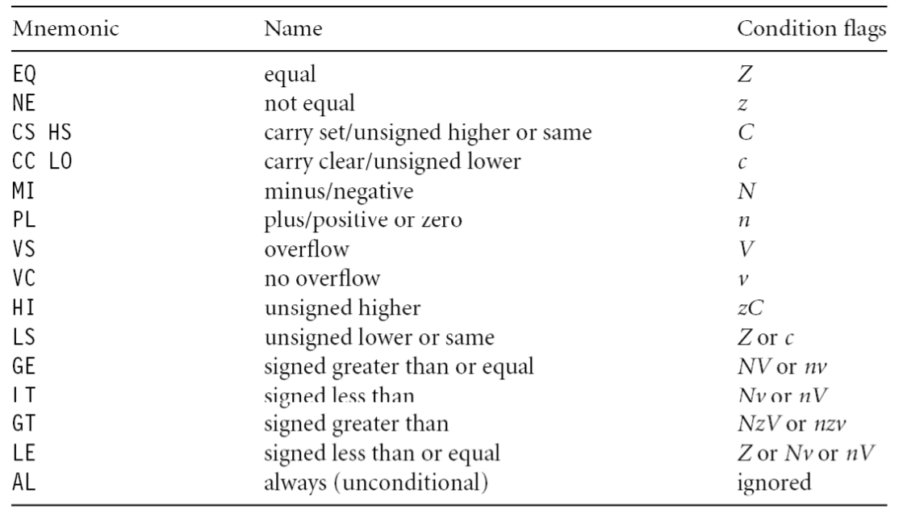
Control flow instructions
Determines which instructions next.
Branch
Branch Conditions

Slide 33
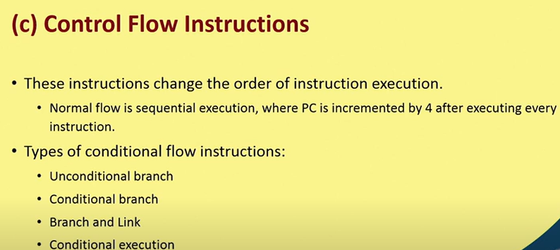

Slide 34
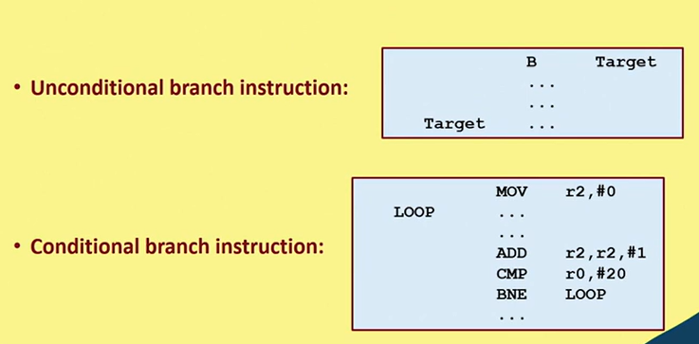

Slide 35
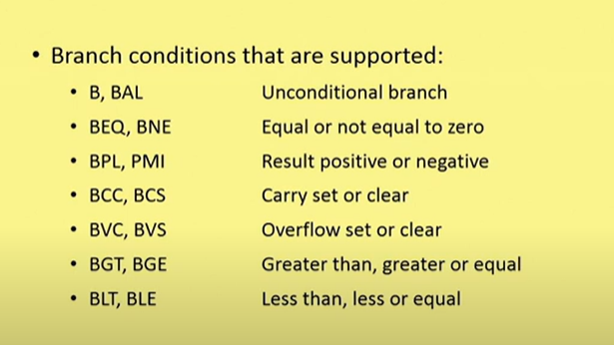

Slide 36
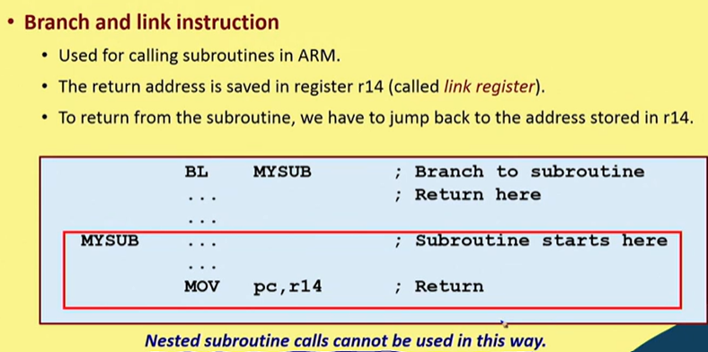

Slide 37
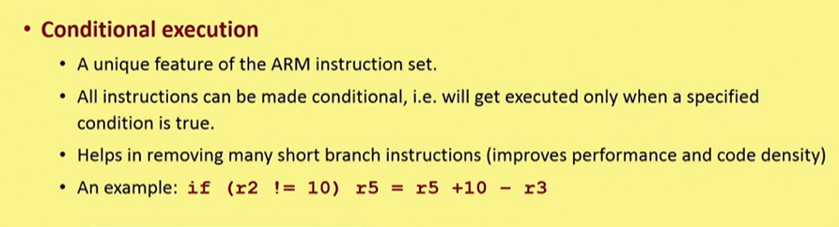
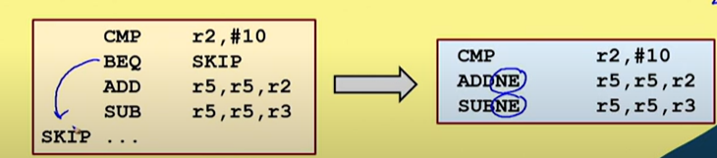

Slide 38
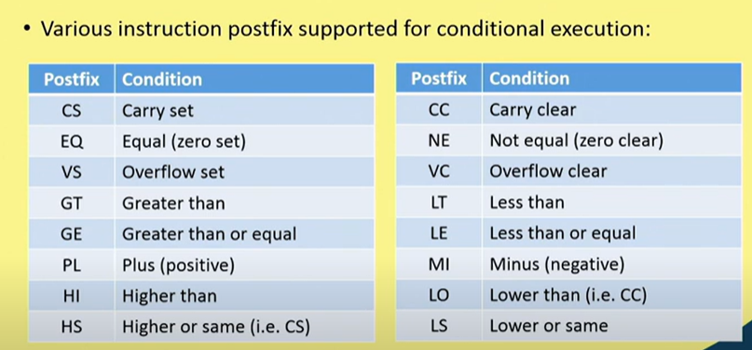

Slide 39
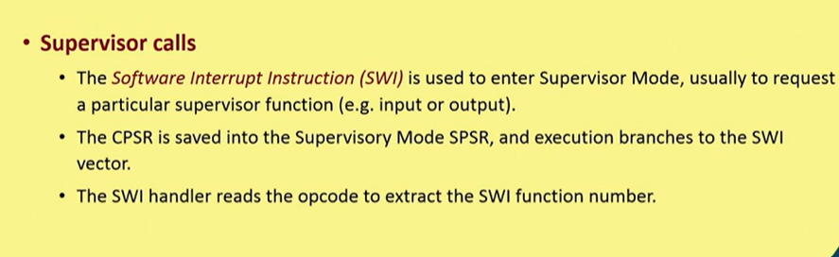

Slide 40
ARM Addressing:
Register Indirect addressing.
Value in one register taken as memory address.
LDR r_{l} , [r_{m}] ; r_{l} = mem[r_{m}]
STR r_{l} , [r_{m}] ; mem[r_{m}] = r_{l}
Offset addressing:
Pre-indexed: LDR r0,[r1,#4]
Pre-indexed with auto-indexing: LDR r0,[r1,#4]!
Post-indexed: LDR r0,[r1],#4

Slide 41
Stack Addressing:
Full ascending
Stack grows up
Base register → highest addr containing valid item.
Empty ascending
Stack grows up
Base register → first empty location above.
Full descending
Stack grows down
Base register → lowest addr containing valid item.
Empty descending
Stack grows down
Base register → first empty location below.

Slide 42
Thank You
References:
Text books: ARM System on Chip Architecture, 2nd edition,by Steve Furber ( Chapter 3 & 5)
https://youtu.be/UdY5RkkT7bg?list=PLbRMhDVUMngcJu5oUhgpgYqtOn7DmSfuU
https://youtu.be/yXSTWW0O1LE?list=PLbRMhDVUMngcJu5oUhgpgYqtOn7DmSfuU
https://youtu.be/xYQ60EqTNuo?list=PLbRMhDVUMngcJu5oUhgpgYqtOn7DmSfuU

